Slide 1

NETFLIX
DATA ANALYSIS
By Meghna Maan

Slide 2

DATA ANALYSIS
Data analysis is the process of cleaning, changing, and processing raw data, and extracting actionable, relevant information that helps businesses make informed decisions. The procedure helps reduce the risks inherent in decision-making by providing useful insights and statistics, often presented in charts, images, tables, and graphs.

Slide 3
PROJECT AIM
Main aim for working on this project was to practice cleaning of the data, plotting graph to just have relative information which will reduce the run time of the program and then finding the relation between the information plotted.
This project will also help in understanding how data is extracted and then related to make better decisions in future.

Slide 4
LIBRARIES USED
Numpy
Pandas
Seaborn
Matplotlib.pyplot
Plotly.express
Textblob

Slide 5

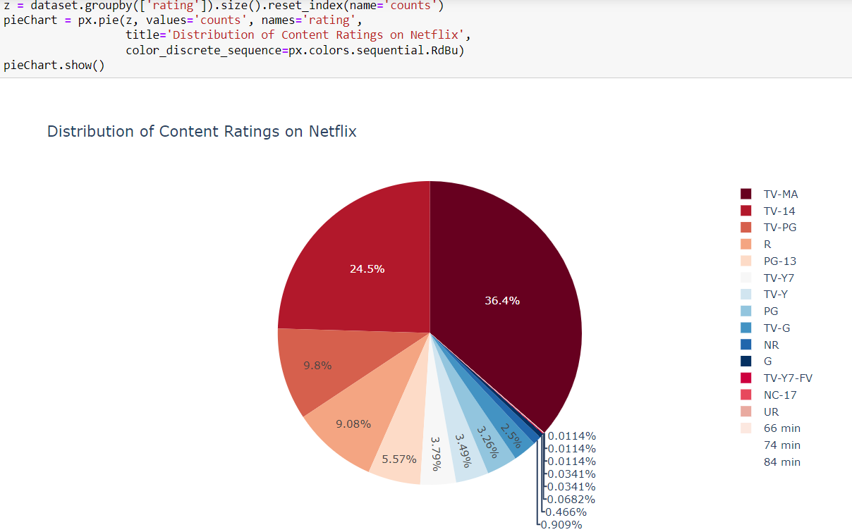
Distribution of Content:

Slide 6
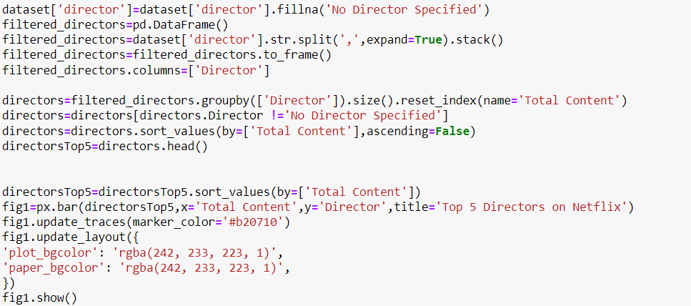
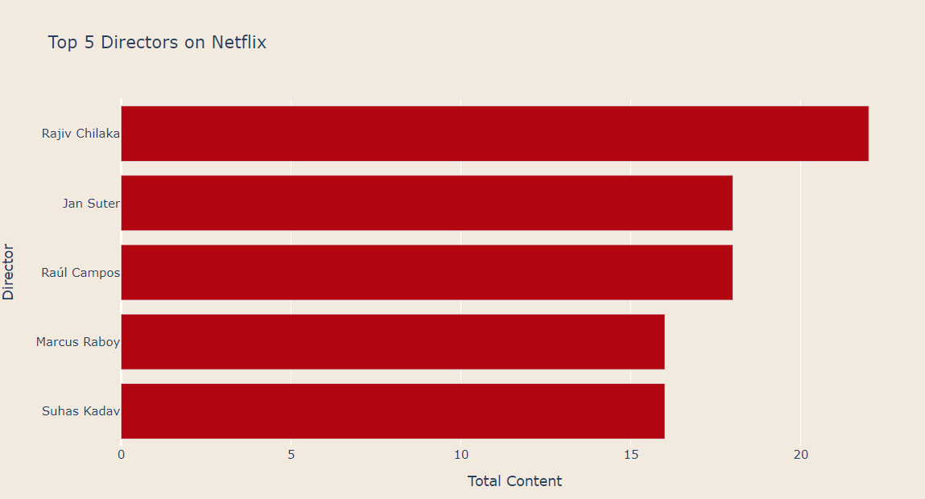
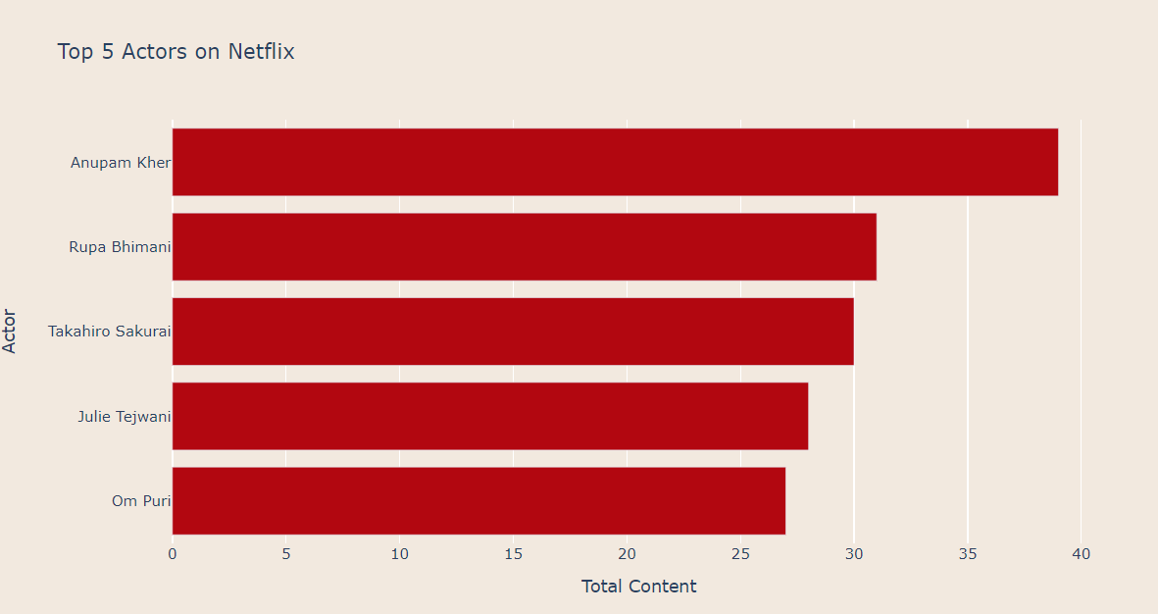
Top 5 Actors and Directors:

Slide 7
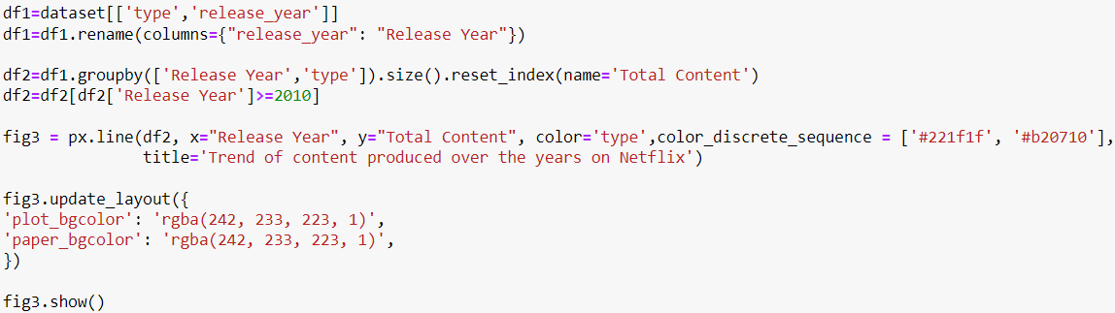
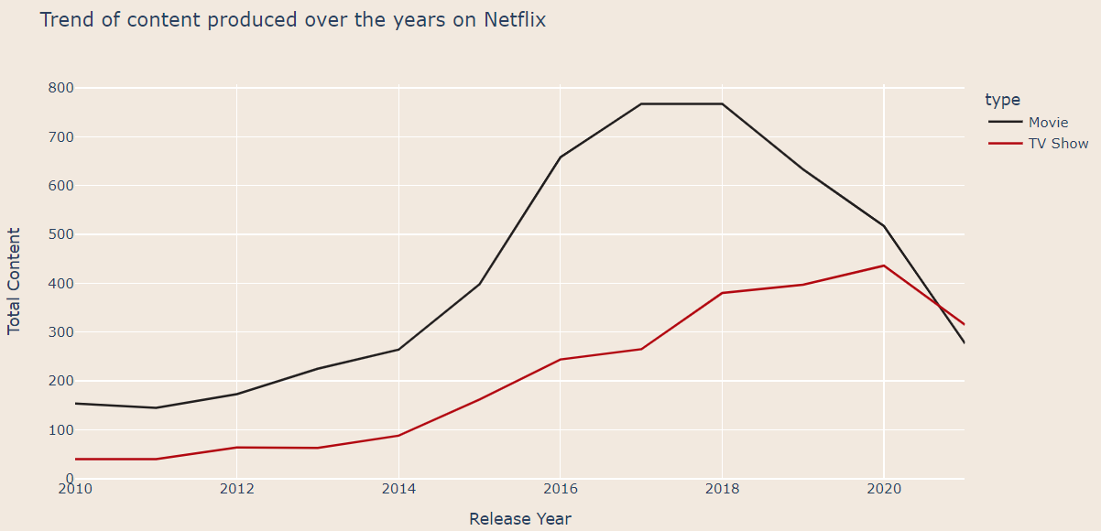
Analyzing Content on Netflix:

Slide 8
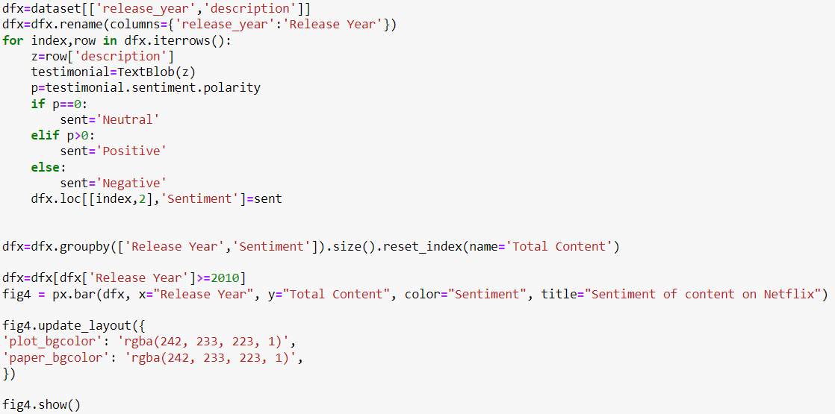
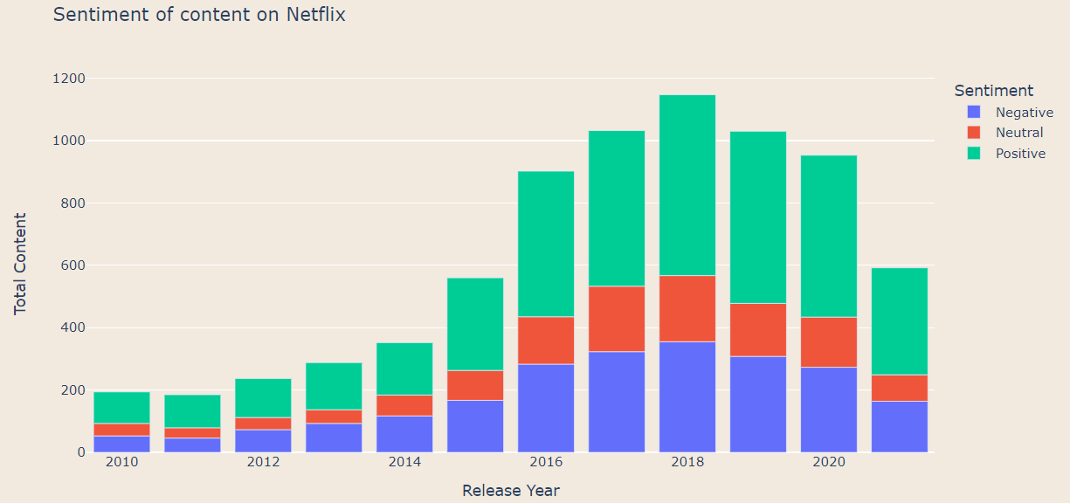
Sentiment of content on Netflix:

Slide 9
THANK
YOU

